Slide 1
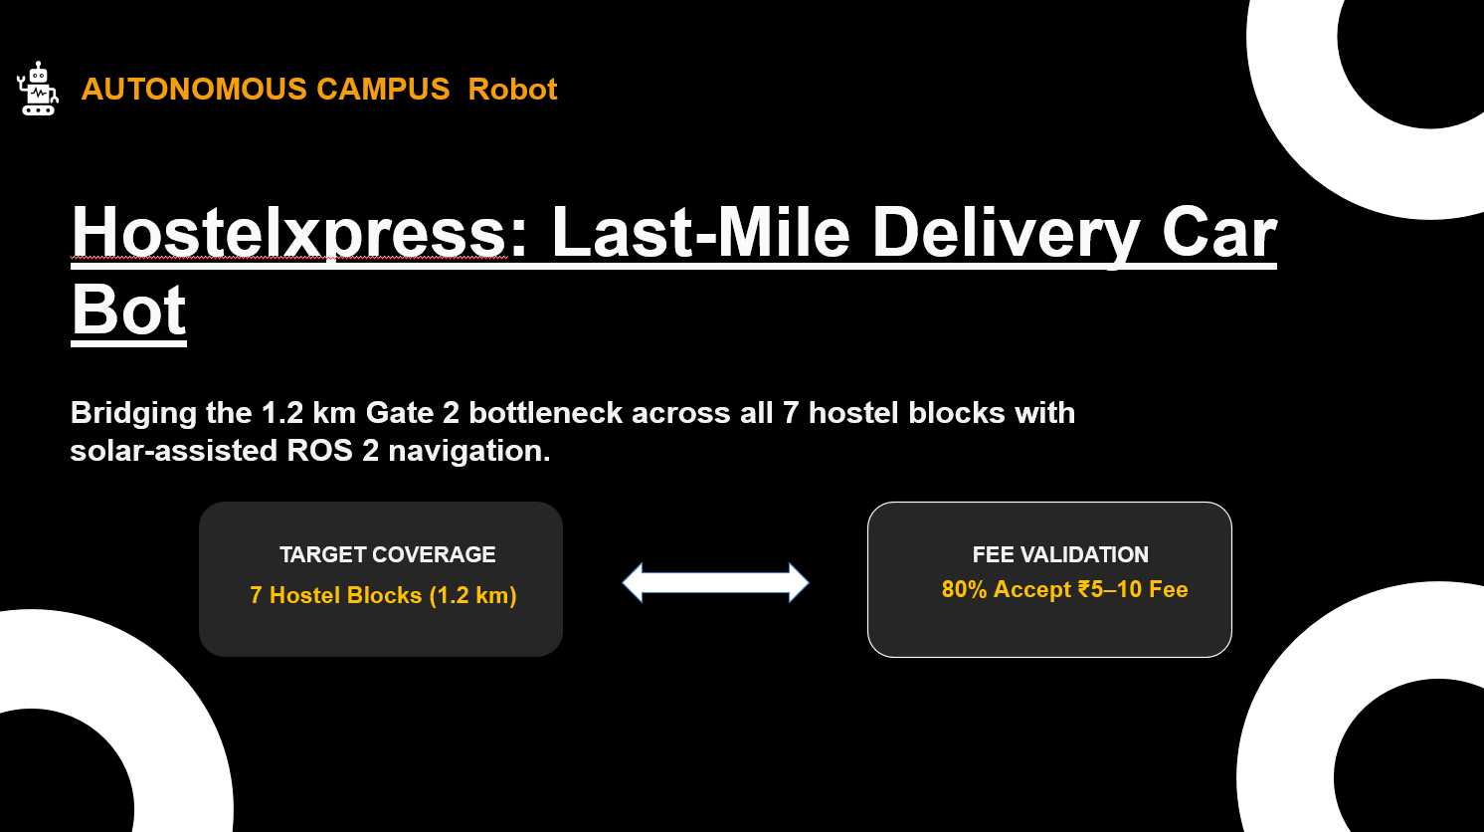

Slide 2


Slide 3
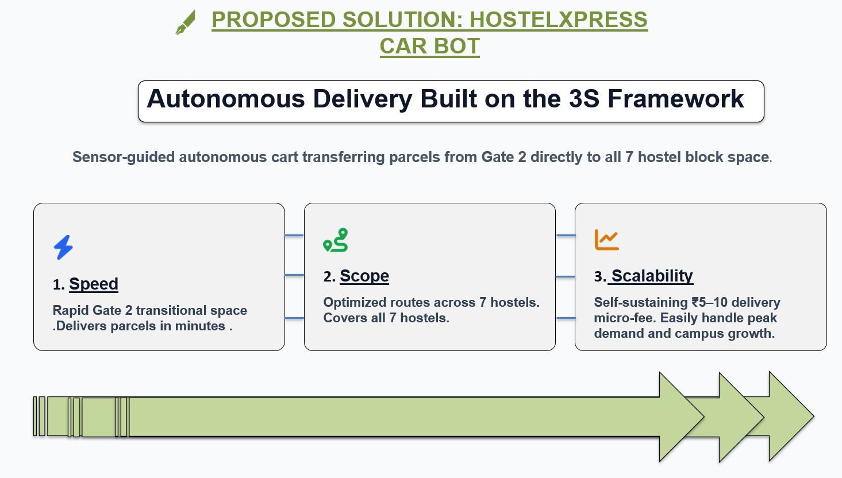

Slide 4
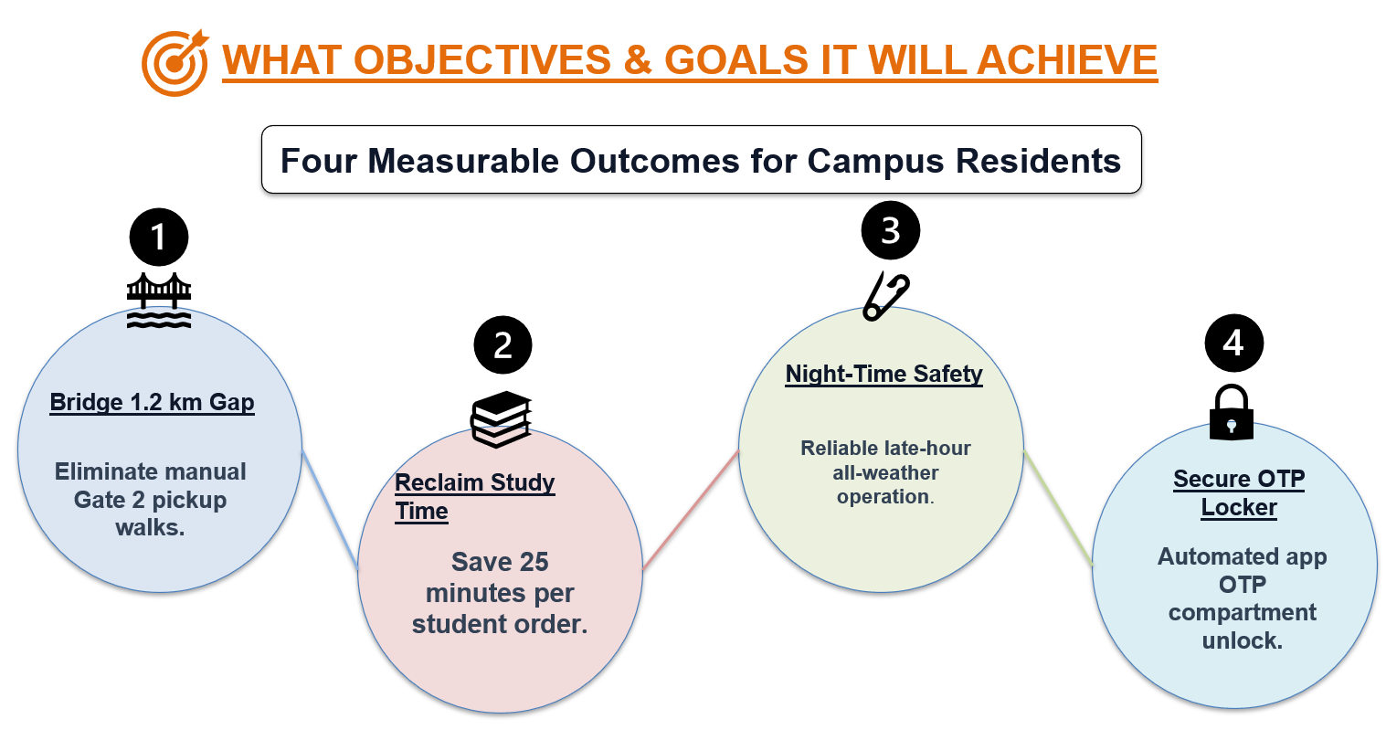

Slide 5
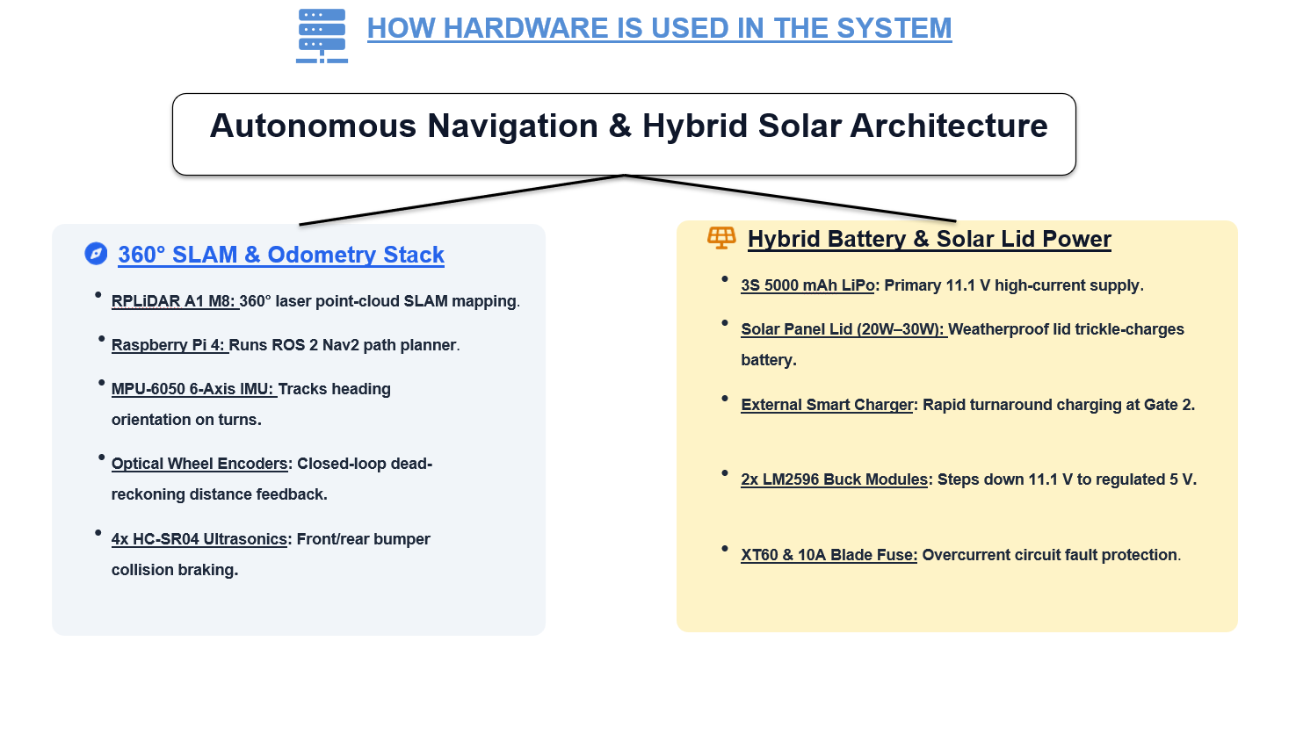

Slide 6
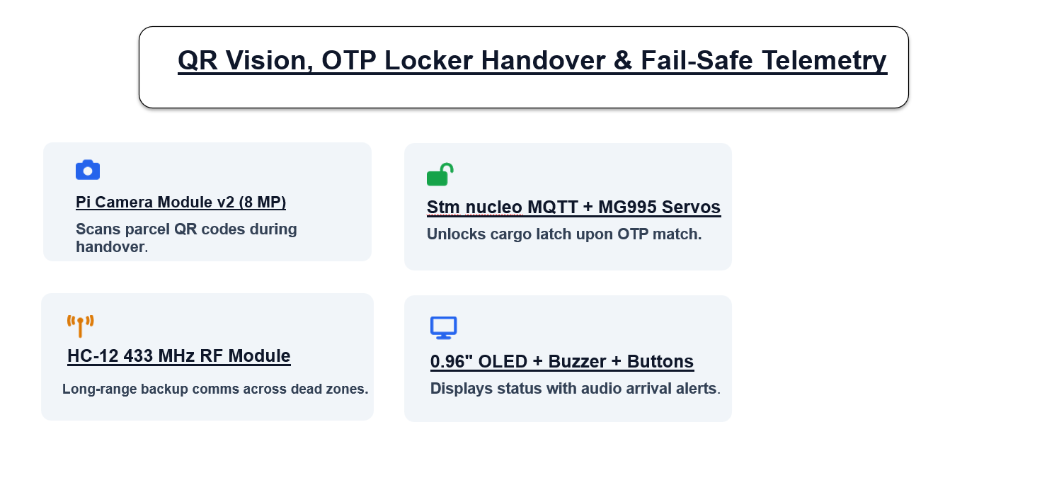
ELECTRONICS COMPONENTS SOM EXCEL SHEET LINK
https://docs.google.com/spreadsheets/d/1aeSkkkKTVZwsgYWNDdfqvCoP_Uc7PPQU/edit?usp=drive_link&ouid=107611539602900839877&rtpof=true&sd=true

